Slide 1
Fall Co-op Report December 5th, 2019

Slide 2
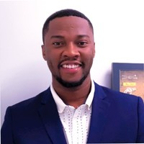
About Me
Randy Akuffo
Information Technology
December 2019
TIM/Premium Support Co-op
Randy Suggs

Slide 3
My Journey @ Landis + Gyr
Summer
Fall
Spring
Spring Task
Worked with the TIE team and Sheila through my training
Took on the CLECO daily support
Importing MMF/CIF/IIF
Working troubled meters
Travelled to AEP with Dave and Justin as a field training
TEP
MTEMC
Case management

Slide 4
My Journey @ Landis + Gyr
Summer
Fall
Spring
Summer Tasks
Point of contact for CLECO
MMF/CIF importations
Helped with settings and configurations after migration
Testing
Austin Energy PDUCRC mitigation
FW upgrade plans
MTEMC Associate Support

Slide 5
My Journey @ Landis + Gyr
Summer
Fall
Spring
Fall Tasks
Continued working with CLECO with help from Lily and Audrey
FW upgrades to fix the supercapacitor issue
Case management
MTEMC Associate Support
Mapping Project

Slide 6
Project Overview Using Cold Fusion, HTML, Bootstrap and JS
Problem
Automation
Visual Output
HTML
Bootstrap CSS
Tool for Mapping Problem meters
Cold Fusion
JavaScript
Database Engines

Slide 7
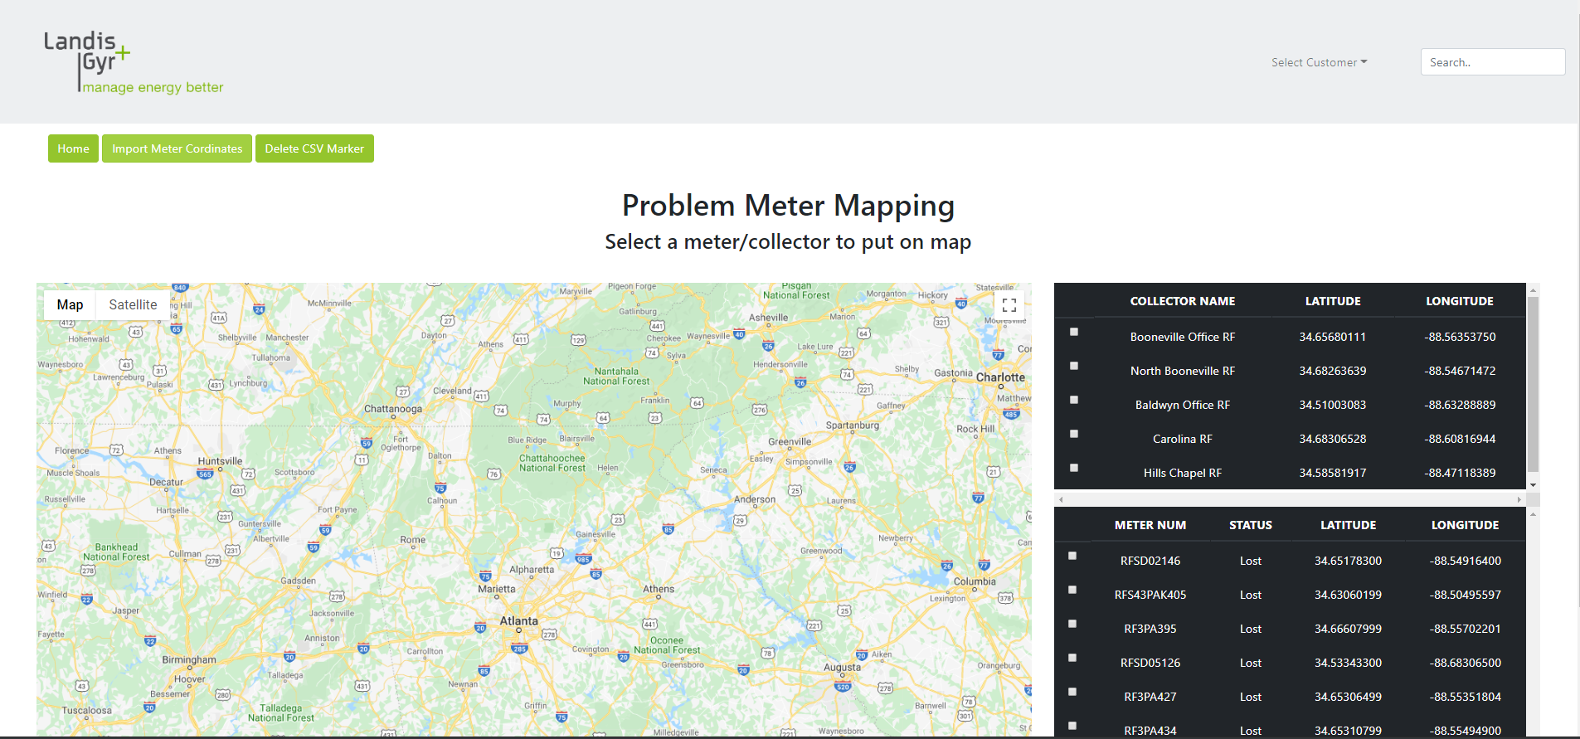

Slide 8
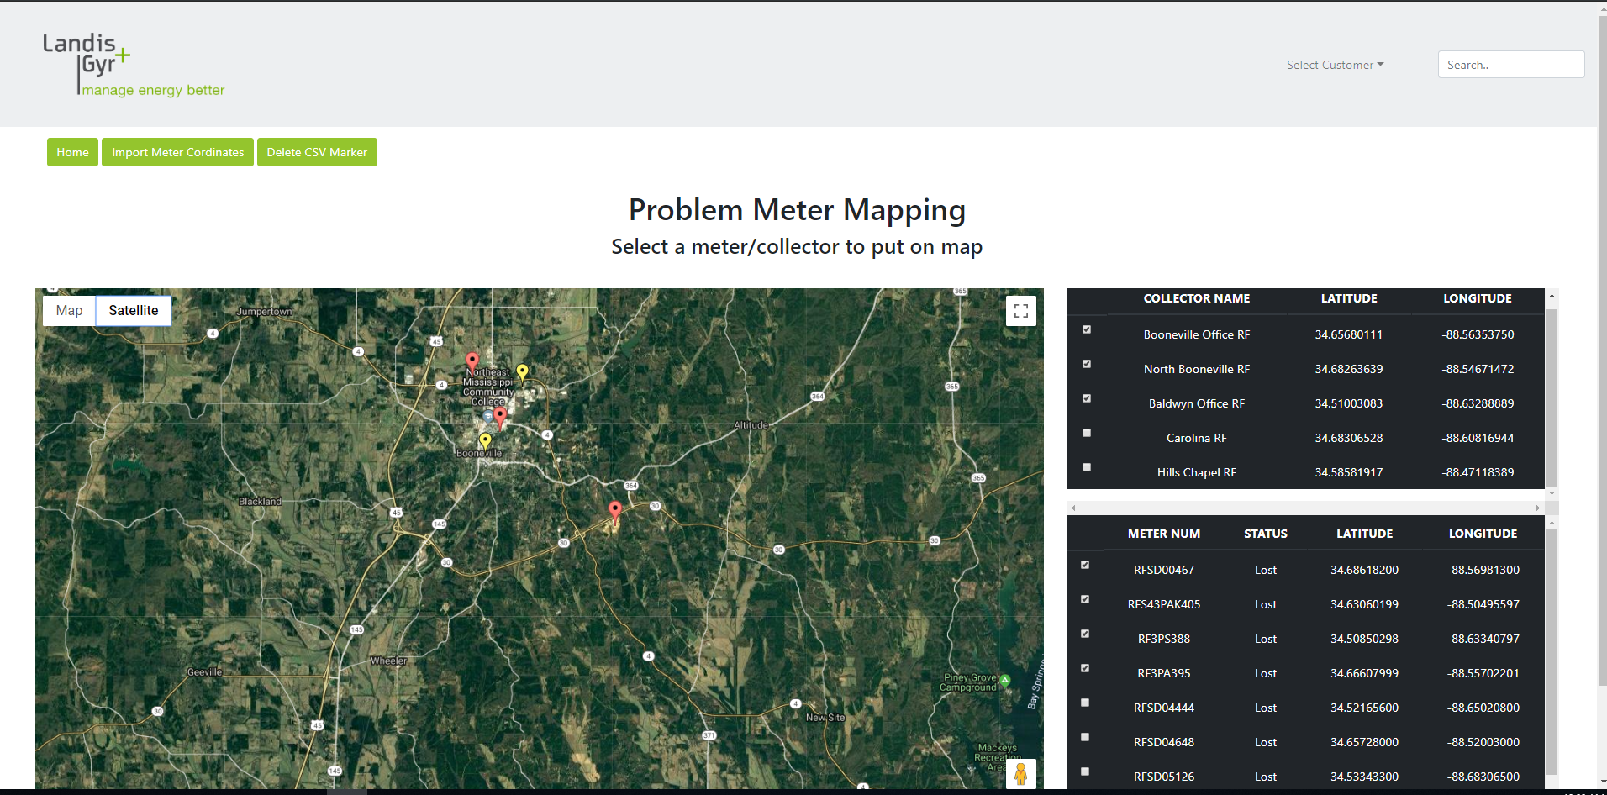

Slide 9

Experience Gained
Tools
Cold Fusion
Radioshop
Command Center
CRM

Slide 10

Experience Gained
Tools
Processes
Cold Fusion
Radioshop
Command Center
CRM
How to upgrade DCW/firmware
Troubleshooting
DCW broadcast
Case/Task Escalation process

Slide 11
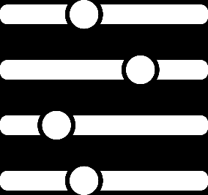
Experience Gained
Tools
Processes
Personal Development
Cold Fusion
Radioshop
Command Center
CRM
How to upgrade DCW/firmware
Troubleshooting
DCW broadcast
Case/Task Escalation process
Teamwork
Time management
Resources management
Communicating with Customers

Slide 12
Good
Team Building Activities
Assistance and Training
Coffee

Slide 13
Appreciations
Randy Suggs (Manager)
TIEs
TIMs

Slide 14
Questions ?

